Slide 1
Holla’ 4 Hands
CS 146 Section B
Harkirat Kang, Christopher Landolfi, Evan Hampp, Hyungho Seo, Matt Luanski
I pledge my honor that I have abided by the Stevens Honor System

Slide 2



Need some help?
Use our resources at Holla’ 4 Hands!
Get matched with the best person to do the job that needs to be done.
Large variety of talented workers
Fit to your needs exactly!

Slide 3

How do I work the website?
Simple!
Click “Request Form” on the navigation bar
Fill out our simple but detailed just enough form
Submit
Get matched with the best person possible to fill your needs!

Slide 4

The Creators - Christopher Landolfi
See that cool website?
Christopher Landolfi was in charge of writing the html for the “Home” page and the “About Us” page.
Chris decided to keep the website clean and simple, with a navigation bar and a space for a javascript to run an image changer on the “Home” page.
Chris came out with a much better understanding of html after this project.

Slide 5
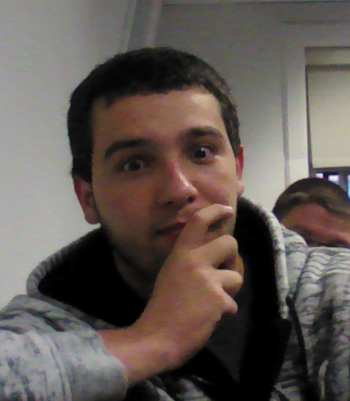

The Creators - Hyungho Seo & Matt Luanski
Hyungho Seo and Matthew Luanski partnered up to create the HTML for the form page necessary to use Holla’ 4 Hands. Struggling to make the form page look as desired, and have enough detail to correctly match people, they used the form code written in class as a reference.
The team came out with a much better understanding of the separate functions of the HTML and CSS files.

Slide 6
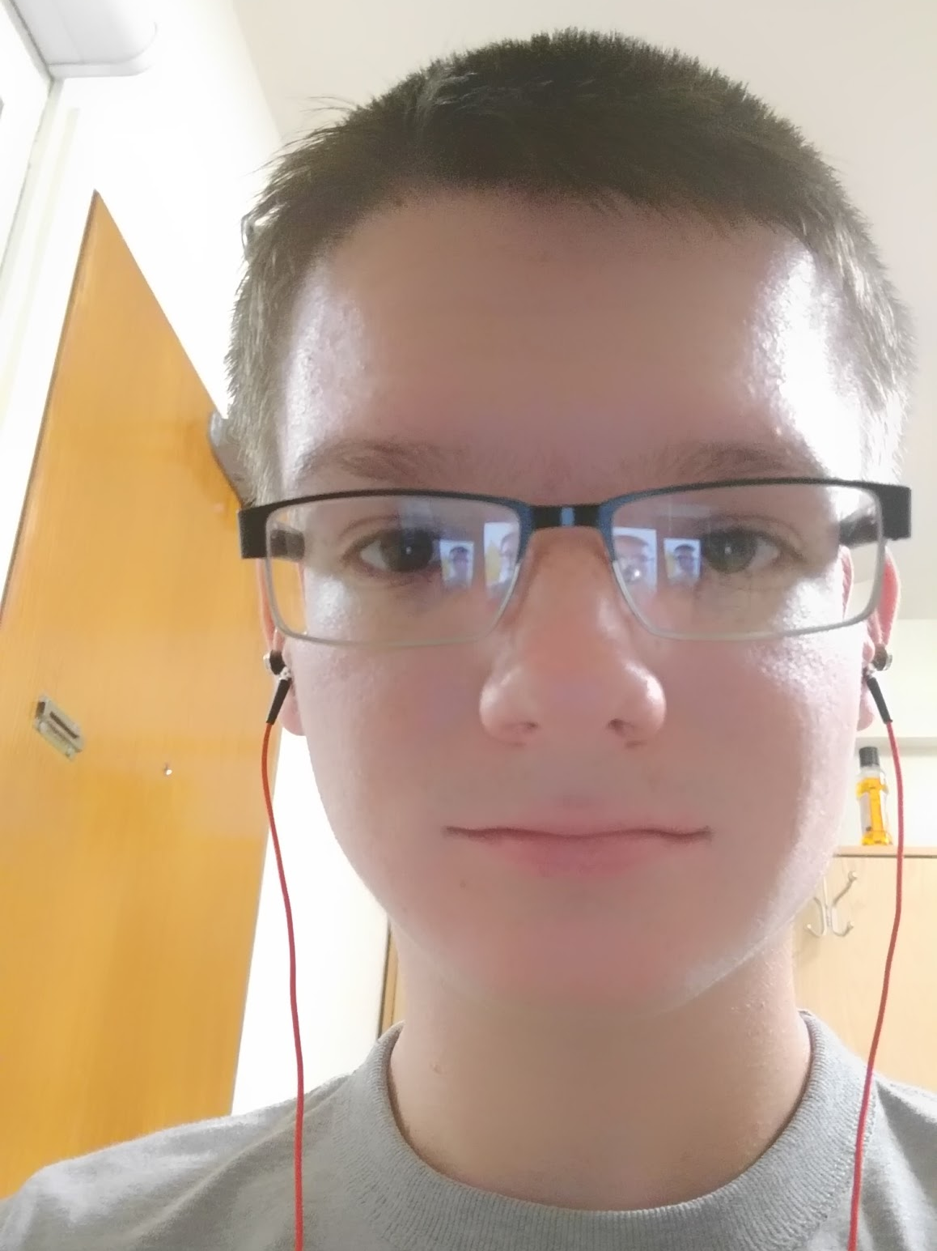
The Creators - Evan Hampp
Evan Hampp took part of the cool movement on the website.
Evan wrote the javascript necessary for the image changer on the “Home” page and wherever else necessary. He also wrote a small amount of css to work well with his javascript. Troubleshooting and debugging the code were the hardest parts.
However, Evan came through with a better understanding of the javascript syntax.

Slide 7
The Creators - Harkirat Kang
Harkirat Kang was in charge of writing the majority of the css. Her abilities in design of simple color schemes were used to give the website a clean feel and used to give the form page a more appealing look.
For her troubles in finding the correct selectors, she referred to past webpages she’s played around with and the W3 Schools website.
Harkirat came out with a much better understanding of the different css selectors.

Slide 8
Holla’ 4 Hands

